Slide 1
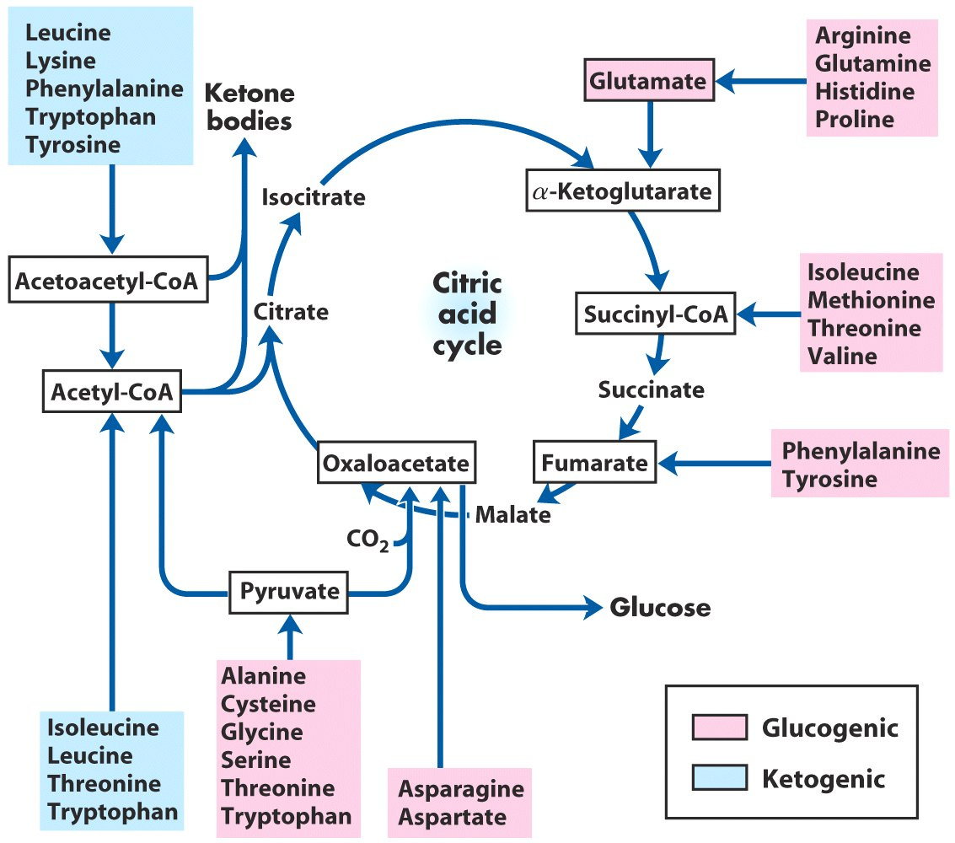
Ketogenic glucogenic
Amino Acid Metabolism
Carbons from the pink amino acids can all participate in gluconeogenesis
Carbons from the blue amino acids can all end up as acetoacetyl-CoA and or acetyl-CoA
If in excess, these can produce ketone bodies, or fatty acids
Trp, Phe, Tyr, Ile are in both categories
Only Leu and Lys are solely ketogenic
Notes:
Can convert to pyruvate

